Slide 1
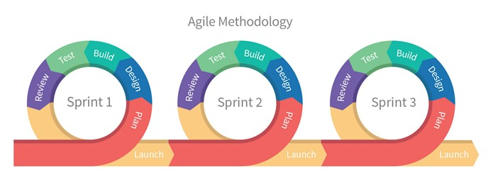
Agile Model

Slide 2
Agile Model
Agile method proposes incremental and iterative approach to software design
The customer has early and frequent opportunities to look at the product and make decision and changes to the project
Agile model is considered unstructured compared to the waterfall model

Slide 3
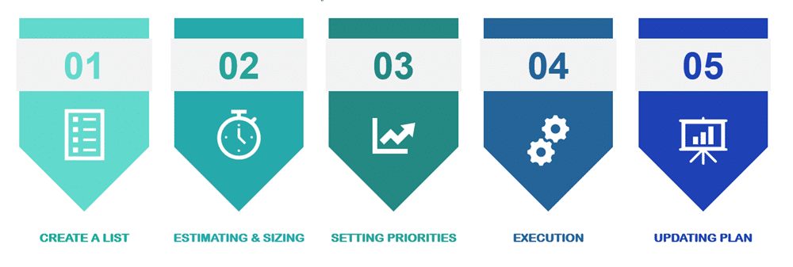
How does Agile work?

Slide 4
How does Agile work?
Create a List: This step includes meeting customer and taking down all the details and features that they want to see in their software. This list of requirements and functions is called the User Requirements List.
Estimating and Sizing: After making the user list, you will size stories relative to each other using Agile Estimation techniques and come up with an estimate of how many days each story would take to complete.

Slide 5
How does Agile work?
Setting Priorities: After giving an estimate you can take customer’s help to know their preference. You can ask them to prioritize their user list so that you can finish the most critical task first and save the least important for the end.
Execution: Now when you know the customer’s priority and have a master story list in place, you can finally start delivering some value to the customer. You start from the top, with the most prior task and work your way down to the bottom for the least prior task. After every delivery, you take feedback from your customer.

Slide 6
How does Agile work?
Updating Plan: As you start delivering the product to the customer, he will come up with some changes. You can include those changes in your list. If required, you will prioritize the list of items.

Slide 7
Advantages of Agile Model
Error can be fixed in the middle of the project.
Dividing into sprints gives the team the opportunity to focus on the individual stages and work faster
Faster feedback loop from end users.
Flexibility in defining priority functions and setting goals
Early and Predictable Delivery
Better Productivity and Quality

Slide 8
Disadvantages of Agile Model
It is not useful for small development projects.
There is a lack of intensity on necessary designing and documentation.
It requires an expert project member to take crucial decisions in the meeting.
Cost of Agile development methodology is slightly more as compared to other development methodology.
The project can quickly go out off track if the project manager is not clear about requirements and what outcome he/she wants.

